Slide 1
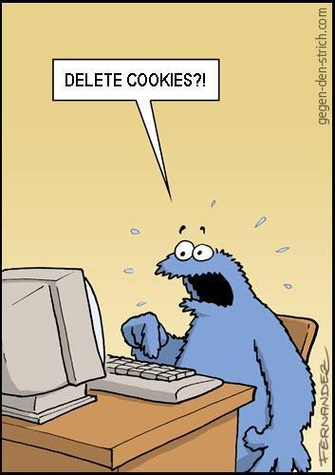
VGP104 - Software Development and Testing
Instructor: Peter Chan

Slide 2
Agenda
Test Cases
Black Box Testing
White Box Testing
Rule #7 - Check the Plug

Slide 3
What is a Test Case?
A set of test inputs, execution conditions, and expected results
Developed for a particular objective such as to verify compliance with a specific requirement
Multiple test cases might be needed to fully test a particular feature

Slide 4
Test Case Design
Test cases should be designed and written by someone who understands the function or technology being tested
Can be written for positive test or negative test
Test case will either pass or fail
The known input should test a precondition and the expected output should test a postcondition

Slide 5
Test Case Format
A formal written test case may include:
    - test case ID
    - test case description
    - step by step actions to perform
    - expected results
    - actual results
    - pass or failed

Slide 6
Black Box Testing
Testing without explicit knowledge of the core structure or code of the application
Test cases are built around the application's design specifications and requirements
Can be applied to all levels of software testing (unit test, integration test, system test, etc)
Can be outsourced

Slide 7
Black Box Testing Techniques
Decision Table
Equivalence Partitioning
Boundary Value Analysis

Slide 8
Decision Table
Contains four quadrants: conditions, condition entries, actions, and action entries
Maps all possible combinations of the conditions to the corresponding actions
Can be simplified if multiple combinations yields the same results

Slide 9
Decision Table
Printer does not print | Y | Y | Y | Y | N | N | N | N
A red light is flashing | Y | Y | N | N | Y | Y | N | N
Printer is unrecognized | Y | N | Y | N | Y | N | Y | N
Check the power cable |  |  | X
Check the data cable | X |  | X
Check printer driver | X |  | X |  | X |  | X
Check ink cartridge | X | X |  |  | X | X
Check for paper jam |  | X |  | X

Slide 10
Equivalence Partitioning
Another method aimed at reducing the total number of test cases
Works by dividing the input data into partitions which generates identical results
Test cases are prepared on each partition to ensure that the application processes the input data correctly with valid input, or throws an error message otherwise

Slide 11
Equivalence Partitioning
Number of Flights | Membership
5 - 10 | Silver
11 - 15 | Gold
16 - 20 | Platinum
21 - 40 | Diamond

Slide 12
Boundary Value Analysis
Test cases are designed to include representatives of boundary values
Values on the minimum and maximum edges of the equivalence partitions are tested
It has been observed that most errors identified during black box testing occurs at the boundaries of the input domain

Slide 13
White Box Testing
Testing that focuses on the internal structures of the software as opposed to its functionality
Requires an internal perspective of the system, as well as programming skills
Inputs are chosen to exercise paths through the code and determine the appropriate output

Slide 14
White Box Testing
Though this method of testing can uncover many errors or problems, it might not detect unimplemented parts or missing requirements
Can be applied at the unit, integration, and system levels of testing
Since the tester has to deal with code directly, this can also help in detecting unnecessary code and optimizations

Slide 15

Rule #7 - Check the Plug

Slide 16
Rule #7 - Check the Plug
Never trust your assumptions, especially when they are at the heart of some unexplainable problems
Ask yourself, "Is it plugged in?"
Are you even running the code you think you are running?
This might seem silly, but it happens a lot!

Slide 17
Rule #7 - Check the Plug
If you depend on memory being initialized before your program runs, make sure you do it explicitly!
If not, sometimes it will work properly and sometimes it won't, which makes it that much harder to fix your bug
You will be surprised how many times this has happened to me at work!

Slide 18
Rule #7 - Check the Plug
Your bad assumptions may not be about the code you have written
Sometimes it could be the tools that you are using that's not working properly
Double check your tool settings
After all, the tools are written by engineers too

